Slide 1
USE CASE DIAGRAM

Slide 2
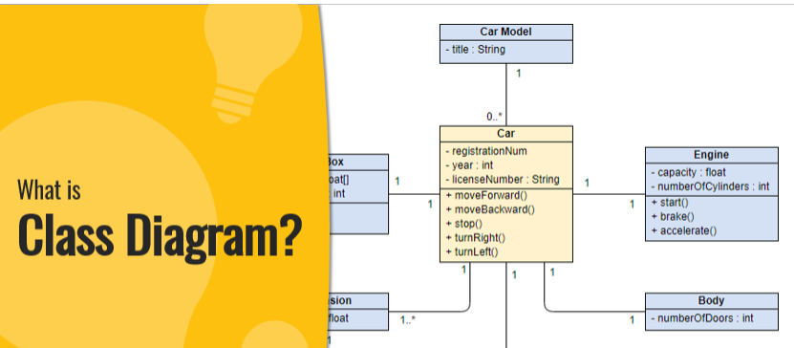

Slide 3
class diagram is a type of static structure diagram that describes the structure of a system by showing the system's classes, their attributes, operations (or methods), and the relationships among objects
The class diagrams are widely used in the modeling of object oriented systems because they are the only UML diagrams, which can be mapped directly with object-oriented languages.
Class diagram shows a collection of classes, interfaces, associations, collaborations, and constraints. It is also known as a structural diagram

Slide 4
Purpose of Class Diagrams
Shows static structure of classifiers in a system
Diagram provides a basic notation for other structure diagrams prescribed by UML
Helpful for developers and other team members too
Business Analysts can use class diagrams to model systems from a business perspective

Slide 5
A UML class diagram is made up of:
A set of classes and
A set of relationships between classes
Class is a description of a group of objects all with similar roles in the system, which consists of:
Structural features
Behavioral features

Slide 6
Structural features (attributes) define what objects of the class "know"
Represent the state of an object of the class
Are descriptions of the structural or static features of a class
Behavioral features (operations) define what objects of the class "can do
Define the way in which objects may interact
Operations are descriptions of behavioral or dynamic features of a class

Slide 7
Class Notation
A class notation consists of three parts:
Class Name
Class Attributes
Class Operations (Methods)

Slide 8
1 Class Name
The name of the class appears in the first partition
2 Class Attributes
Attributes are shown in the second partition.
The attribute type is shown after the colon.
Attributes map onto member variables (data members) in code.

Slide 9
3 Class Operations (Methods)
Operations are shown in the third partition. They are services the class provides.
The return type of a method is shown after the colon at the end of the method signature.
The return type of method parameters is shown after the colon following the parameter name.
Operations map onto class methods in code

Slide 10
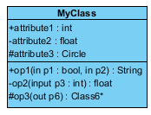
3 attributes
3 operations

Slide 11
Class Relationships
A class may be involved in one or more relationships with other classes.
Relationship Type
Inheritance (or Generalization)
Simple Association
Aggregation
Composition
Dependency

Slide 12
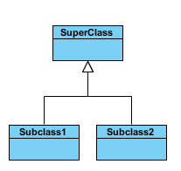
1 Inheritance (or Generalization):
Represents an "is-a" relationship.
An abstract class name is shown in italics.
SubClass1 and SubClass2 are specializations of Super Class.
A solid line with a hollow arrowhead that point from the child to the parent class

Slide 13

2 Simple Association:
A structural link between two peer classes.
There is an association between Class1 and Class2
A solid line connecting two classes

Slide 14

3 Aggregation:
It represents a "part of“ relationship
Class2 is part of Class1.
Many instances (denoted by the *) of Class2 can be associated with Class1.
Objects of Class1 and Class2 have separate lifetimes.
A solid line with an unfilled diamond at the association end connected to the class of composite

Slide 15

Composition:
Objects of Class2 live and die with Class1.
Class2 cannot stand by itself.
A solid line with a filled diamond at the association connected to the class of composite

Slide 16

Dependency:
Exists between two classes if the changes to the definition of one may cause changes to the other (but not the other way around).
Class1 depends on Class2
A dashed line with an open arrow

Slide 17
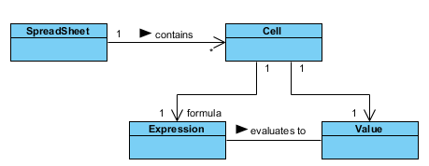
Relationship Names
Names of relationships are written in the middle of the association line.
They often have a small arrowhead to show the direction in which direction to read the relationship,

Slide 18
Visibility of Class attributes and Operations
In object-oriented design, there is a notation of visibility for attributes and operations. UML identifies four types of visibility: public, protected, private, and package.
The +, -, # and ~ symbols before an attribute and operation name in a class denote the visibility of the attribute and operation

Slide 19
+ denotes public attributes or operations
- denotes private attributes or operations
# denotes protected attributes or operations
~ denotes package attributes or operations

Slide 20
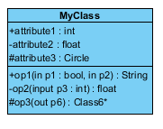
Class visibility example
attribute1 and op1 of MyClassName are public
attribute3 and op3 are protected.
attribute2 and op2 are private.

Slide 21
ACTIVITY DIAGRAM

Slide 22
UML models basically three types of diagrams
structure diagrams
interaction diagrams
behavior diagrams. An activity diagram is a behavioral diagram i.e. it depicts the behavior of a system

Slide 23
An activity diagram focuses on condition of flow and the sequence in which it happens. We describe or depict what causes a particular event using an activity diagram.
An activity diagram portrays the control flow from a start point to a finish point showing the various decision paths that exist while the activity is being executed.
We can depict both sequential processing and concurrent processing of activities using an activity diagram.
They are used in business and process modelling where their primary use is to depict the dynamic aspects of a system.

Slide 24

components used in the diagram and the standard notations
1 Initial State – The starting state before an activity takes place is depicted using the initial state.

Slide 25
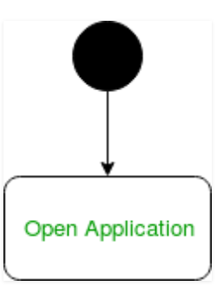
Figure – notation for initial state or start state
A process can have only one initial state unless we are depicting nested activities. We use a black filled circle to depict the initial state of a system. For objects, this is the state when they are instantiated. The Initial State from the UML Activity Diagram marks the entry point and the initial Activity State.
For example – Here the initial state is the state of the system before the application is opened.

Slide 26
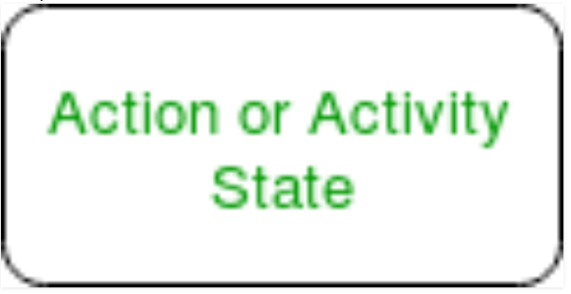
2 Action or Activity State
An activity represents execution of an action on objects or by objects. We represent an activity using a rectangle with rounded corners. Basically any action or event that takes place is represented using an activity.

Slide 27

Action Flow or Control flows
Action flows or Control flows are also referred to as paths and edges. They are used to show the transition from one activity state to another.

Slide 28
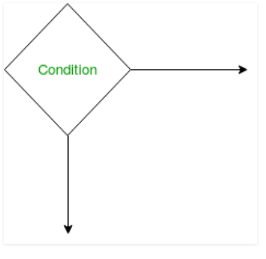
Decision node and Branching
When we need to make a decision before deciding the flow of control, we use the decision node

Slide 29
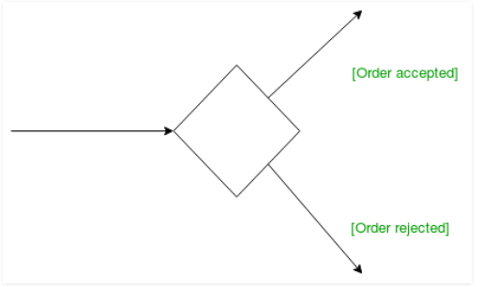
Guards – A Guard refers to a statement written next to a decision node on an arrow sometimes within square brackets

Slide 30
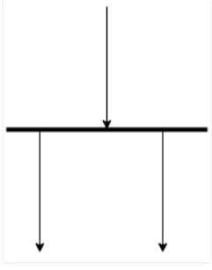
Fork – Fork nodes are used to support concurrent activities

Slide 31
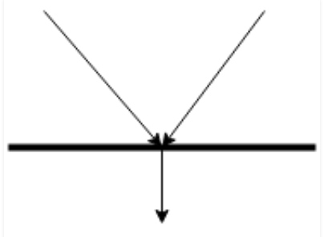
Join – Join nodes are used to support concurrent activities converging into one. For join notations we have two or more incoming edges and one outgoing edge

Slide 32
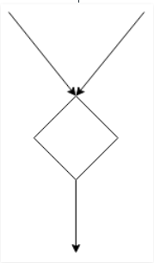
8 Merge or Merge Event – Scenarios arise when activities which are not being executed concurrently have to be merged. We use the merge notation for such scenarios. We can merge two or more activities into one if the control proceeds onto the next activity irrespective of the path chosen

Slide 33
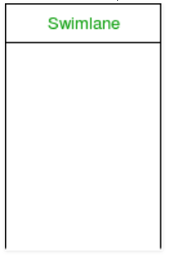
9 Swimlanes – We use swimlanes for grouping related activities in one column. Swimlanes group related activities into one column or one row. Swimlanes can be vertical and horizontal. Swimlanes are used to add modularity to the activity diagram. It is not mandatory to use swimlanes

Slide 34

10 Time event
We can have a scenario where an event takes some time to complete. We use an hourglass to represent a time event

Slide 35

11 Final State or End State – The state which the system reaches when a particular process or activity ends is known as a Final State or End State. We use a filled circle within a circle notation to represent the final state in a state machine diagram. A system or a process can have multiple final state

Slide 36
Uses of an Activity Diagram –
Dynamic modelling of the system or a process.
Illustrate the various steps involved in a UML use case.
Model software elements like methods,operations and functions.
We can use Activity diagrams to depict concurrent activities easily.
Show the constraints, conditions and logic behind algorithm

